Slide 1
Ranking Tasks: Velocity-Time Graphs

Slide 2
Rank the following from least to greatest acceleration:
On a scale of 0-10, how confident are you?
(0=guessed, 10=100% confident)

Slide 3
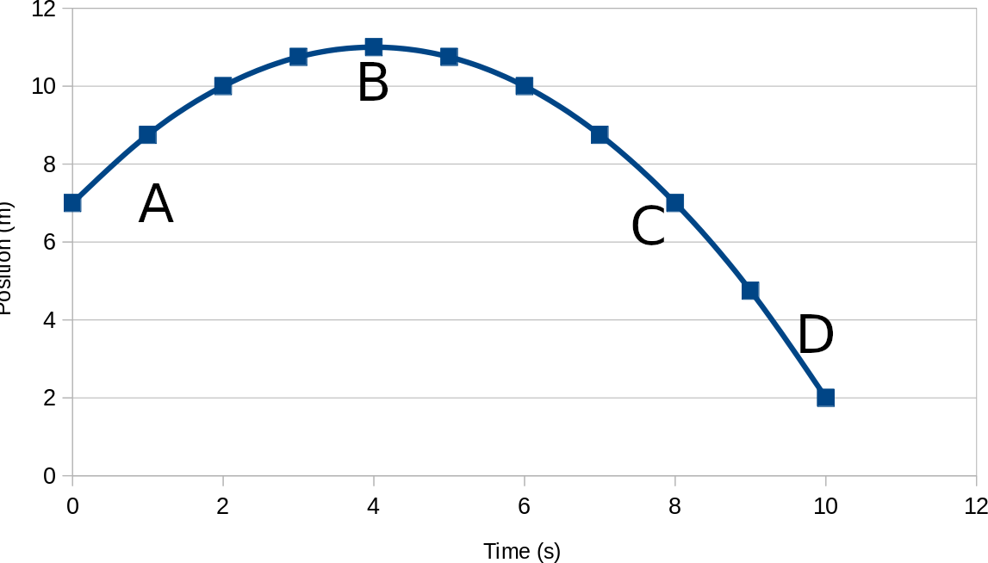
Rank the following from least to greatest velocity:
On a scale of 0-10, how confident are you?
(0=guessed, 10=100% confident)

Slide 4
Rank the following from least to greatest speed:
On a scale of 0-10, how confident are you?
(0=guessed, 10=100% confident)

Slide 5
Rank the following from least to greatest acceleration:
On a scale of 0-10, how confident are you?
(0=guessed, 10=100% confident)

Slide 6
Rank the following from least to greatest acceleration:
On a scale of 0-10, how confident are you?
(0=guessed, 10=100% confident)

Slide 7
Rank the following from least to greatest displacement:
On a scale of 0-10, how confident are you?
(0=guessed, 10=100% confident)

